Slide 1
iSample: Intelligent Client Sampling in Federated Learning
Hamidreza Imani, Jeff Anderson
Advisor: Tarek El-Ghazawi
May 2022

Slide 2

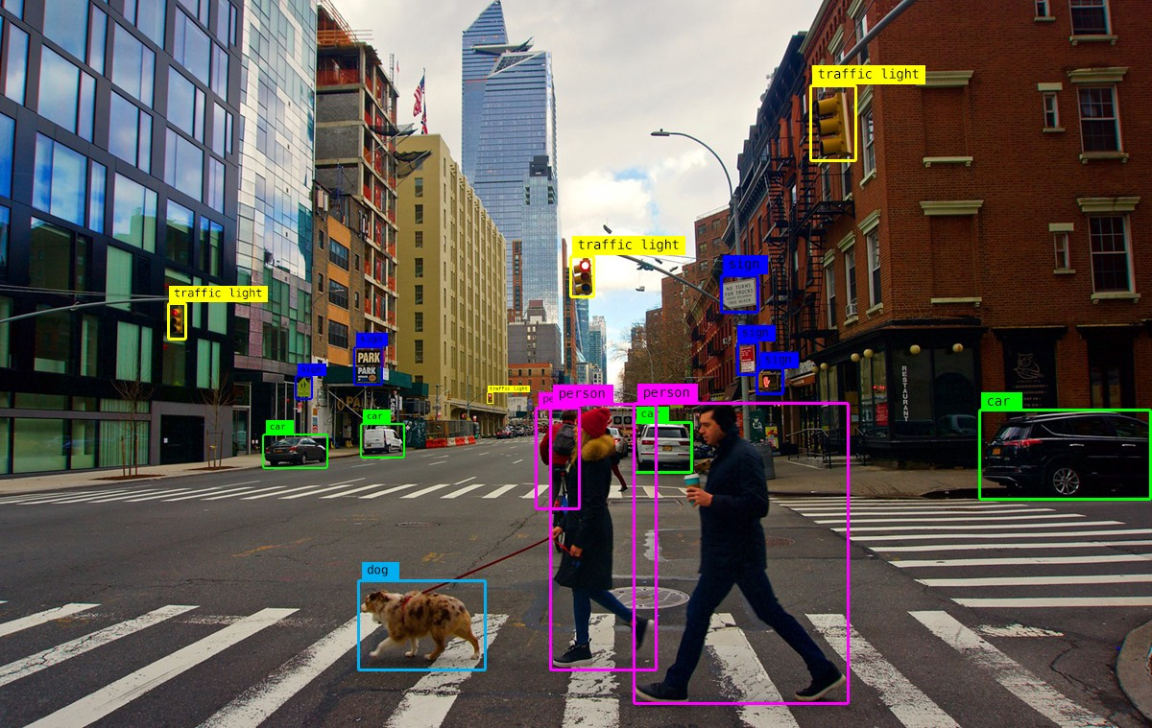

Introduction – Artificial Intelligence
Pervasiveness of Artificial Intelligence in society
Machine Learning: an inseparable tool of our daily used devices
Large amount of training data required to train accurate models
However: not enough data on any single device (IoT, edge devices, etc.)

Slide 3
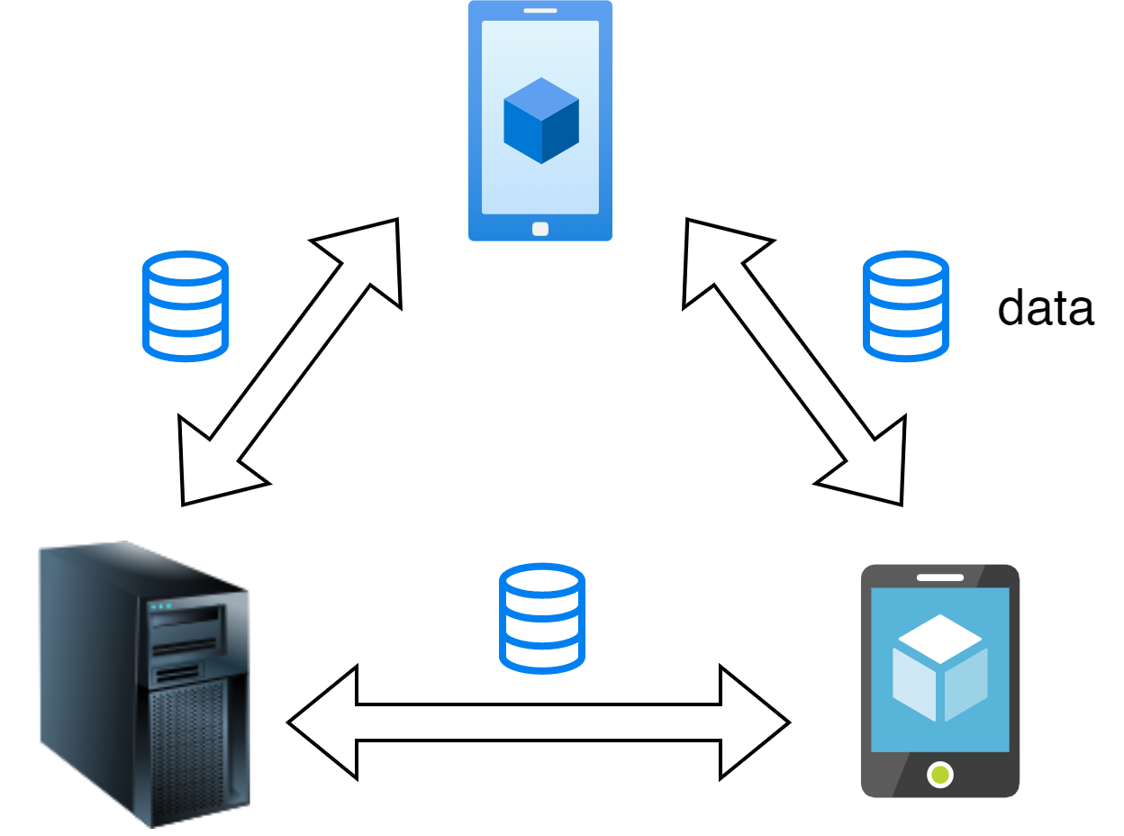
Introduction – Aggregating Data from Multiple Devices
Issues:
Large size training data for typical ML applications → Heavy load on network
Various types of devices → scalability ↓
Privacy problems when dealing with personal information

Slide 4
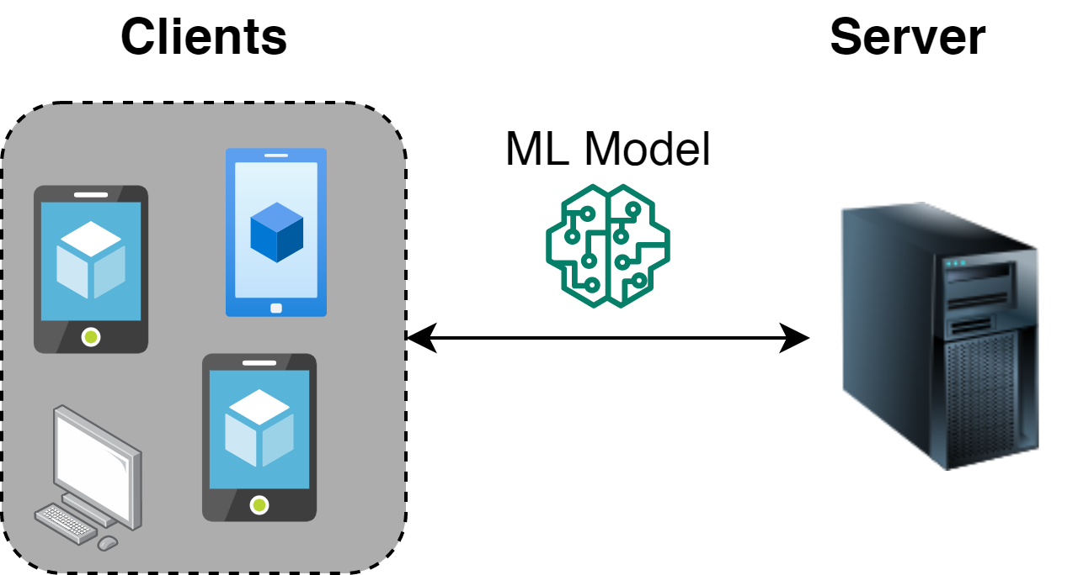
Introduction – Federated Learning (FL)
A decentralized communication efficient ML paradigm:
Decentralized training
Centralized model aggregation
Exchanging ML models instead of training data
Maintaining privacy
Less network load

Slide 5
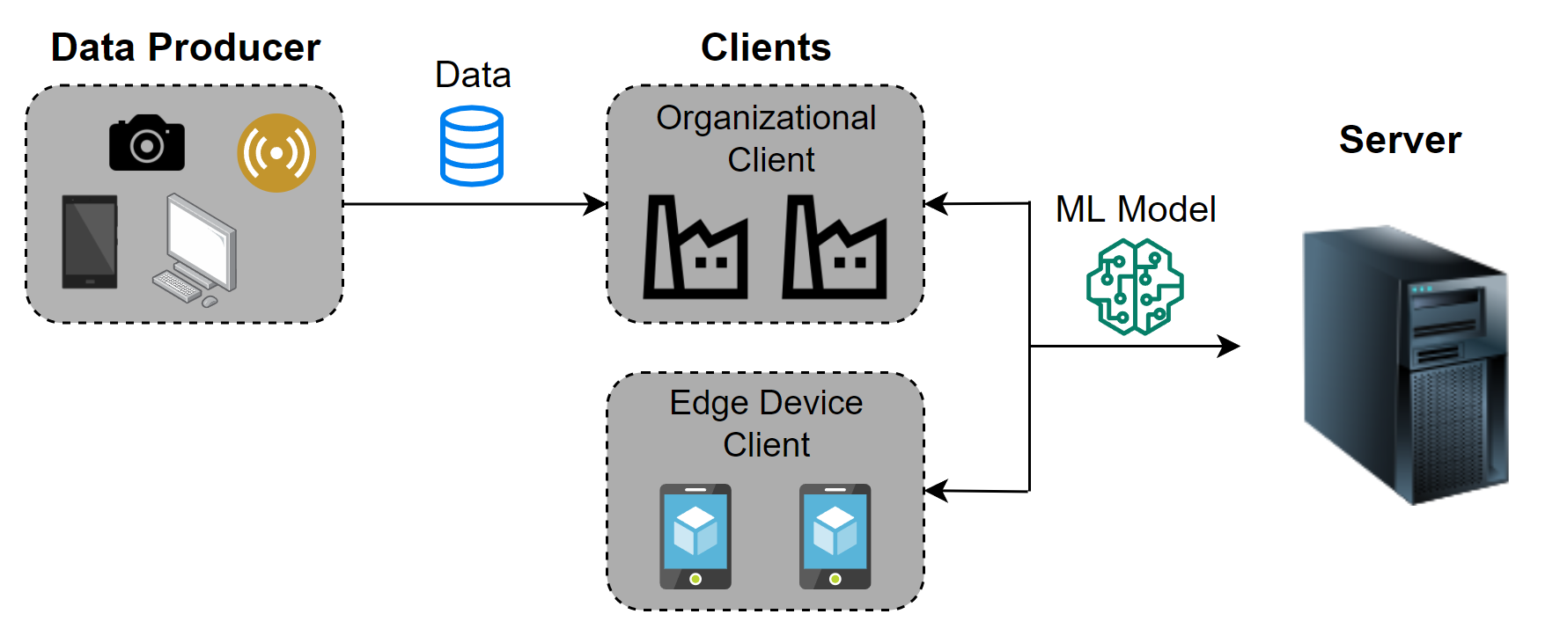
Introduction – FL Challenges
Communication overhead
ML model size varies from megabytes to gigabytes
Heterogeneity:
Organizational clients:
Higher computation and network resources
Private datasets
Data producers
Edge devices

Slide 6
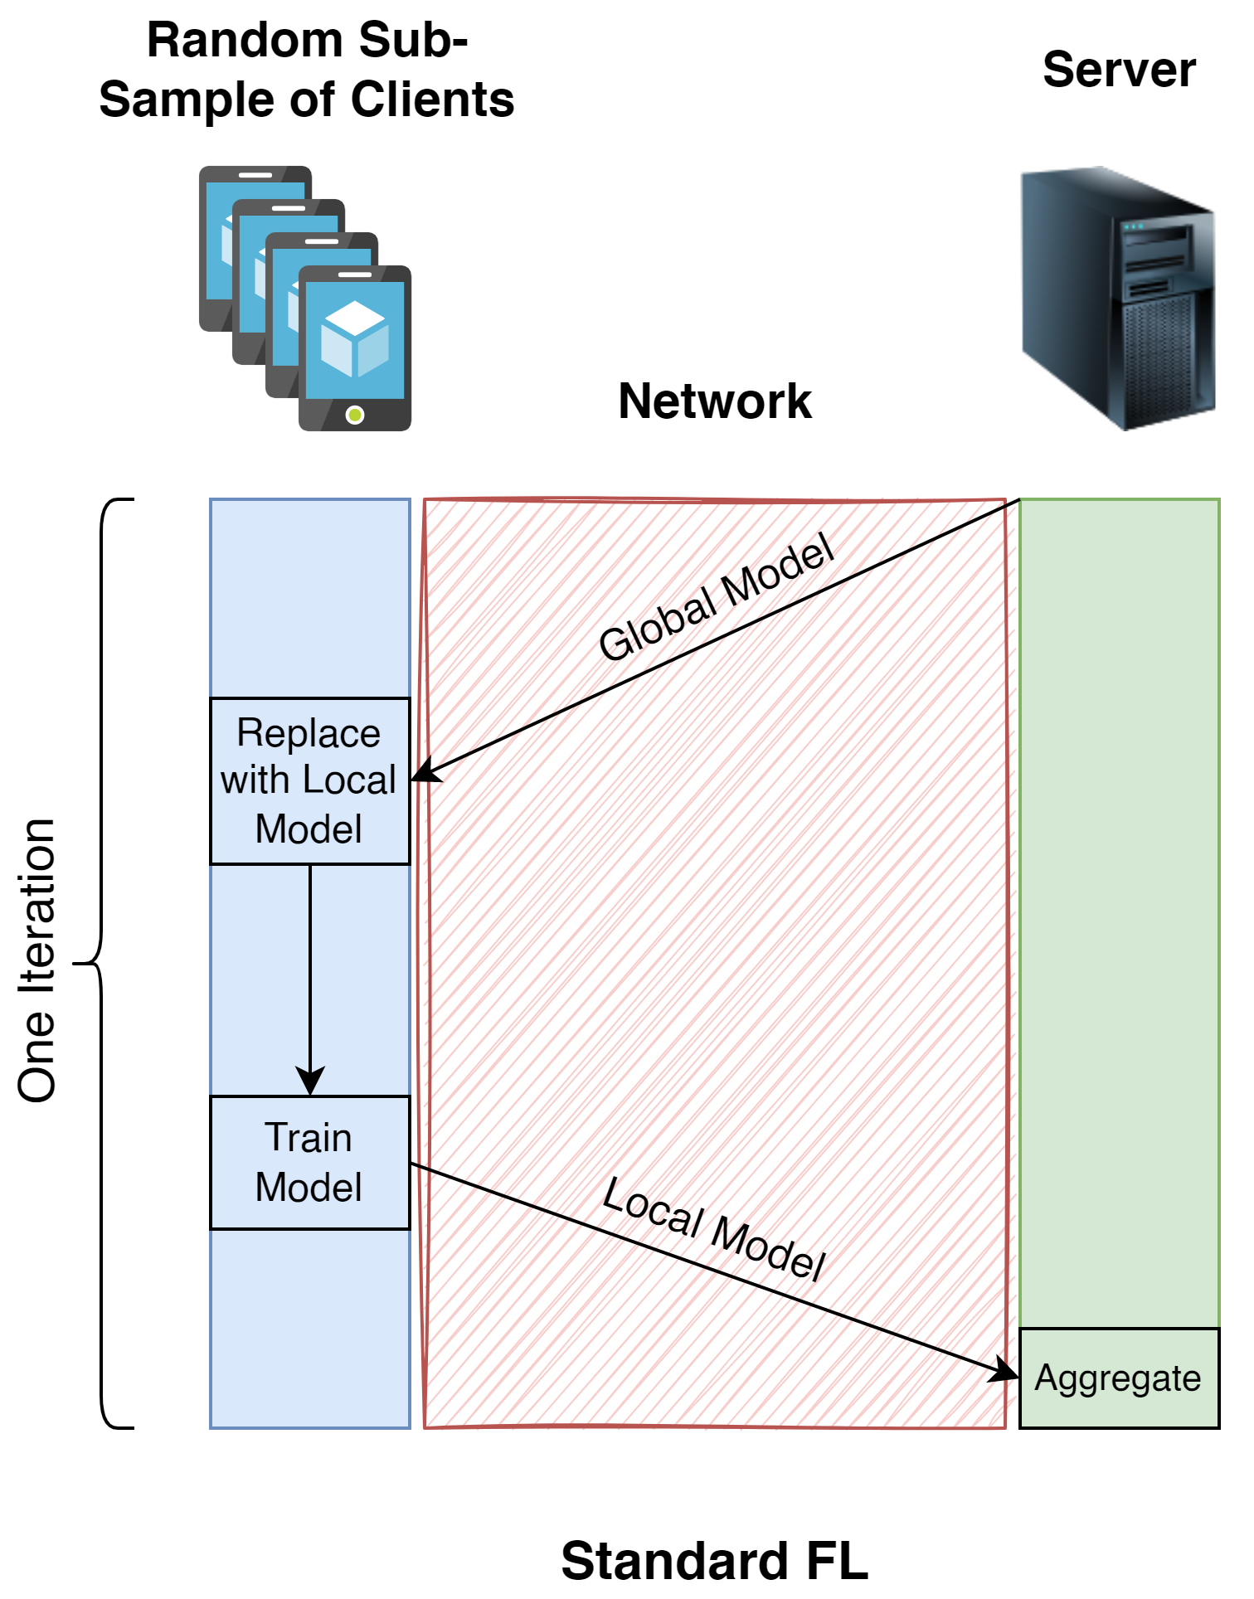
Prior Works – Standard FL
Standard FL: Originally proposed in [1]
Low performance in heterogeneous environments due to the stragglers
Not inclusive → global model is provided to a subsample of clients
No information about client resources and model quality asdasda
Good performance in Non-IID environments
[1] B. McMahan, E. Moore, D. Ramage, S. Hampson, and B. A. y Arcas, “Communication-efficient learning of deep networks from decentralized data,” in Artificial intelligence and statistics.

Slide 7
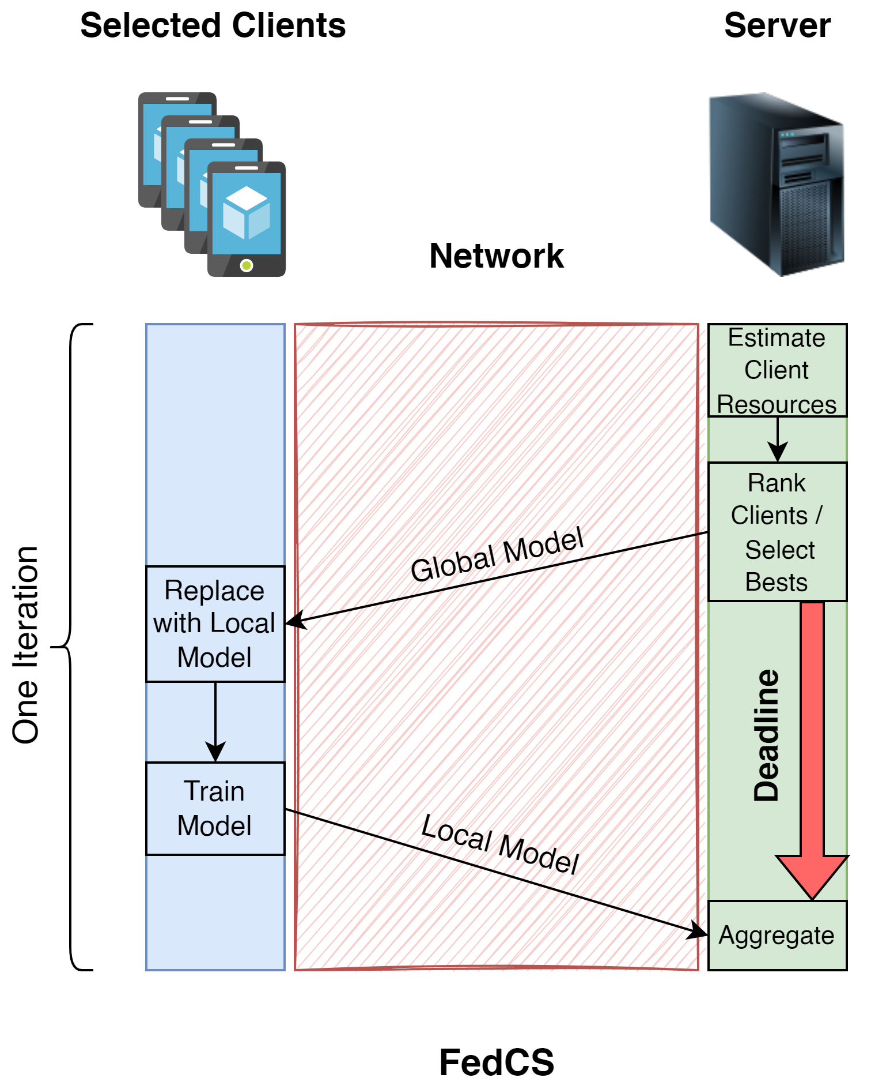
Prior Works - FedCS
Estimating clients’ completion time
Providing the model only to the fastest clients
Better network performance → shorter iteration time
Not inclusive → ignoring the clients with poor resources (even with valuable information)
[2] T. Nishio and R. Yonetani, “Client selection for federated learning with heterogeneous resources in mobile edge,” in ICC 2019-2019 IEEE International Conference on Communications (ICC).

